Slide 1

Computer Programming, Basics
Linux2

Slide 2
Headlines
Source Control
Linux1
Linux2
Compilers1
Compilers2
Golang1
Golang2
Golang3

Slide 3
What about last Homework?
Create a lexical analyzer that read the configuration of your program which indicates this:
the-direction:
type: minus (or add)
amount: 2
And with this configuration update your Redis key-value and then commit hourly.
Example of a config:
the-direction:
type: minus
amount: 10

Slide 4
yacc/bison
yacc: Yet Another Compiler Compiler
Parses and does semantic analysis on the stream of tokens produced by lex.
Bison: a parser generator that is a part of GNU project. The parser reads the sequence of tokens and decides whether the sequence conform to the syntax specified by grammer or not.
It is free like flex (in comparison to lex and yacc)

Slide 5
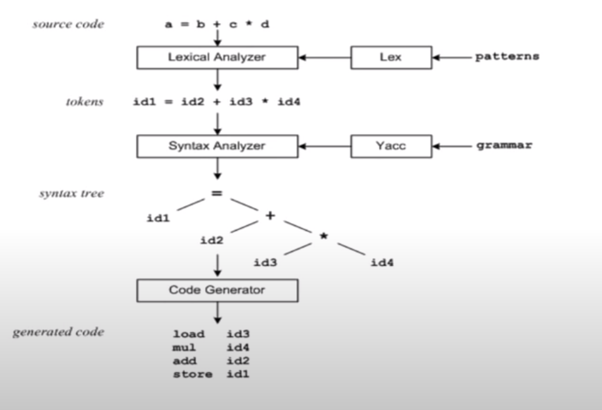

Slide 6
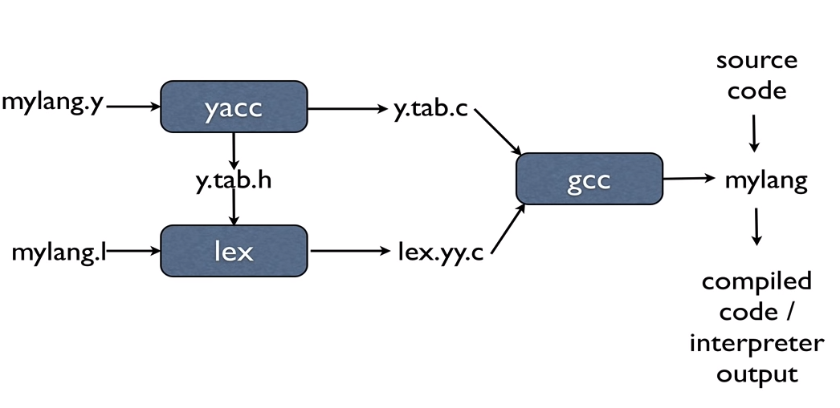
The process

Slide 7
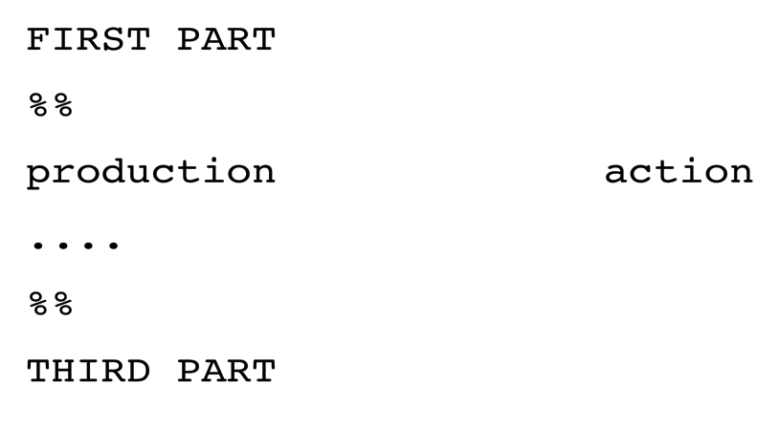
yacc input

Slide 8
yacc – first part
First part of a yacc declaration inclues:
C declarations enclosed in %{ %}
yacc definitions
%start – first one rule
%token – they are coming back from lex analysis
%union – token of different types
%type – type of tokens

Slide 9
yacc - productions
The middle section represents a grammer – a set of productions.
Left-hand side: Right-hand side 1 |
Right-hand side 2
Actions associated to a rule are entered in braces.
Left-hand side: Right-hand side 1 | {Action 1}
Right-hand side 2 {Action 2}
An Example:
statements: statement {printf(“statement”);}
| statement stamtements {printf(“Statements\n”);}
statement: identifier ‘+’ identifier {printf(“plus”);}
statement: identifier ‘-’ identifier {printf(“minus”);}

Slide 10
yacc - productions
$1, $2, $3, … $n can be refer to the values associated with the symbols.
$$ refer to the value of the left-hand side (non-terminal side).
Every symbol have a value associated with it (including tokens and non-terminals)
Default Action:
$$ = $1
Example:
statement: identifier ‘+’ identifier {$$ = $1 + $3;}
statement: identifier ‘-’ identifier {$$ = $1 - $3;}

Slide 11
yacc – third part
Contains valid C code that supports the language processing.
Symbol table implementation.
Functions that might be called by actions associated with the productions in the second part.

Slide 12
Practice, yacc
First, create a simple parser that print a line in screen, and then
Write a parser that do
some primary assignments and
math functions like +, -, *, /.

Slide 13
Homework 1 ☺
Create a simple grammer that saves value in a file (instead of printing):
save 1+2;
It means that save the result in a file called: output.txt

Slide 14
Homework 2 ☺☺
Create a very simple language that has these grammers:
Assignments:
a = 5;
increment a 5;
It means that increment a by 5.
decrement a 4;
It means that decrement a by 4.
print a;
It will print the value of a.
save a;
It will save the value of a in a file called: save.txt
exit;
Will exit the program.
Your commiter program will commit a random number between 0 and the value saved in save.txt ☺

